Slide 1
Presentation Flow
Background
Objectives and Purpose of the Research
Problems to be investigates
Literature and Related Work Reviewed
Design and Prototyping Methodology
Design reviews: Mechanical, Electrical, Software
Assembly Review
Results and Conclusion
Recommendations
Closing notes

Slide 2

Design of a White Lab Component Vending Machine
Prepared by:
Baden David Morgan
MRGBAD001
Notes:
Welcome + background to study
In the current setup at white lab components are provided during the working day with some down time. It closes at 5 and this can cause frustration with students who like to work into the night as most engineers do. This is were the Component Vending machine came to be theorized. With a 24/7 operational vending machine for components students would be able to obtain components at any time of theday or night.

Slide 3
Objectives and Purpose of the Research
Reliably dispense individual components
Internet connected and controllable
Self contained and user friendly
Stock components and make it easy to restock
Notes:
Objectives and Purpose of the research
Reliably dispense on a regular basis 24/7 from a Component Vending Machine
For online ordering and control
The designs must be easy to use for the end user
Methods and ideas into restocking for quantity and functionality

Slide 4
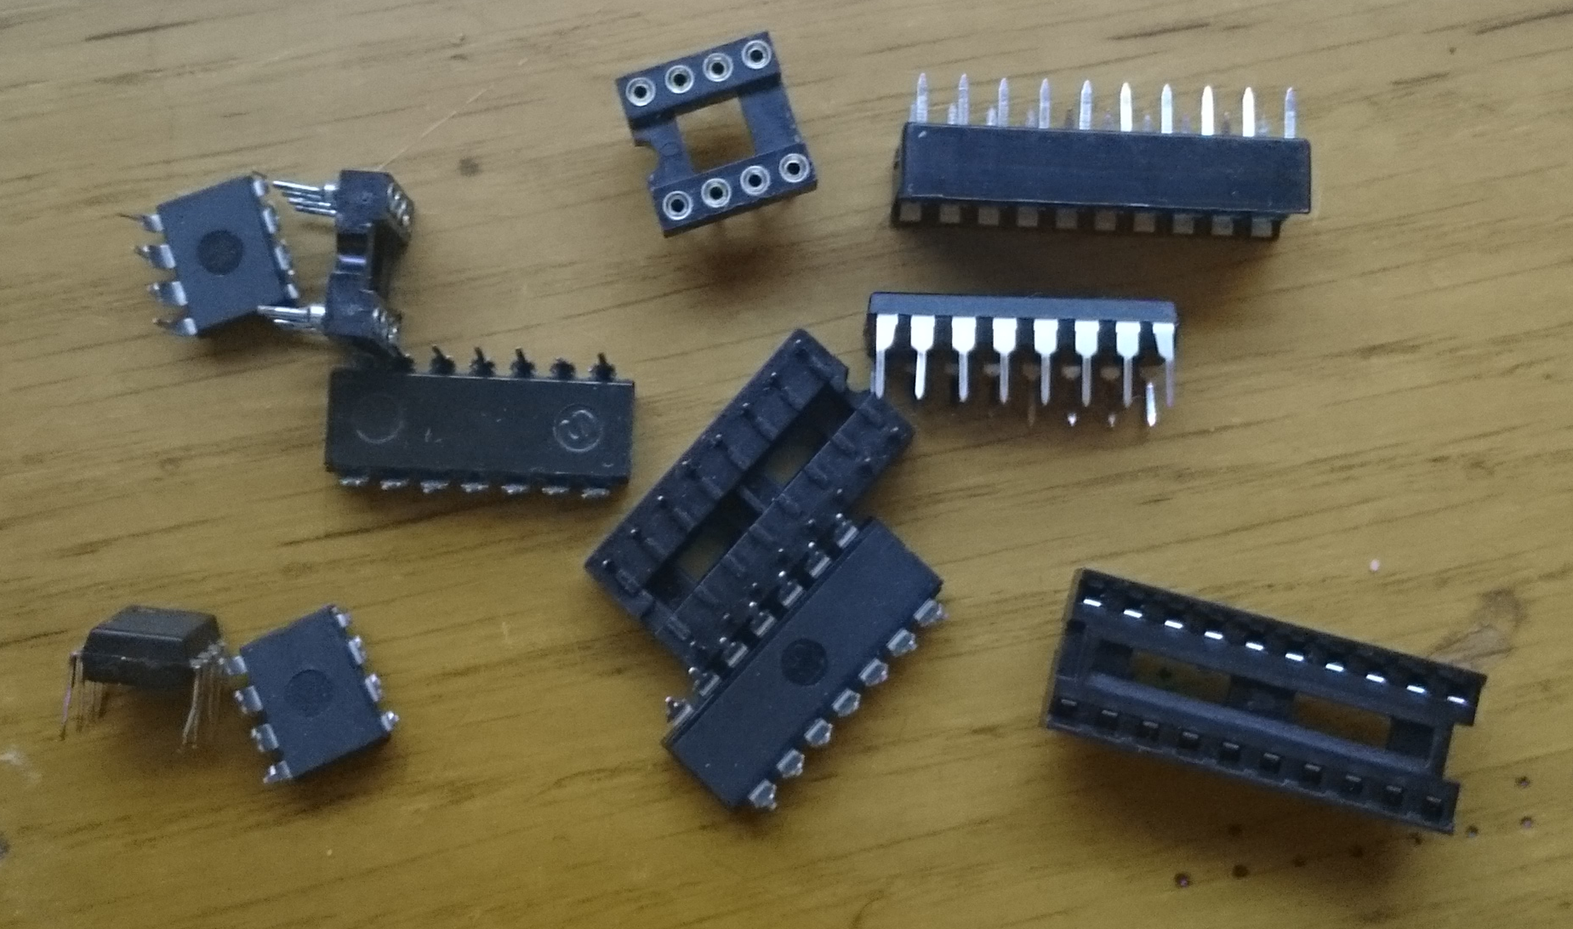
Problems to be investigated
Mechanical Delivery Mechanism
Internet Viability
Enclosure Design
PCB and Circuit Design
Software Requirements
Assembly
Notes:
Problems to be investigated:
Would be investigated
Main was the delivery mechanism
Dispense one component at a time
Limited to DIP components
95% reliability rating
What hardware and software would be needed to sufficiently control and connect such a device at the compont VM
An enclosure that could make the VM self contained
Circuit and PCB design to control the delivery mechanism
Software, MCU,MASTER WEBSITE
Assembly of a working prototype and possibly deployable VM for further testing and evaluation

Slide 5
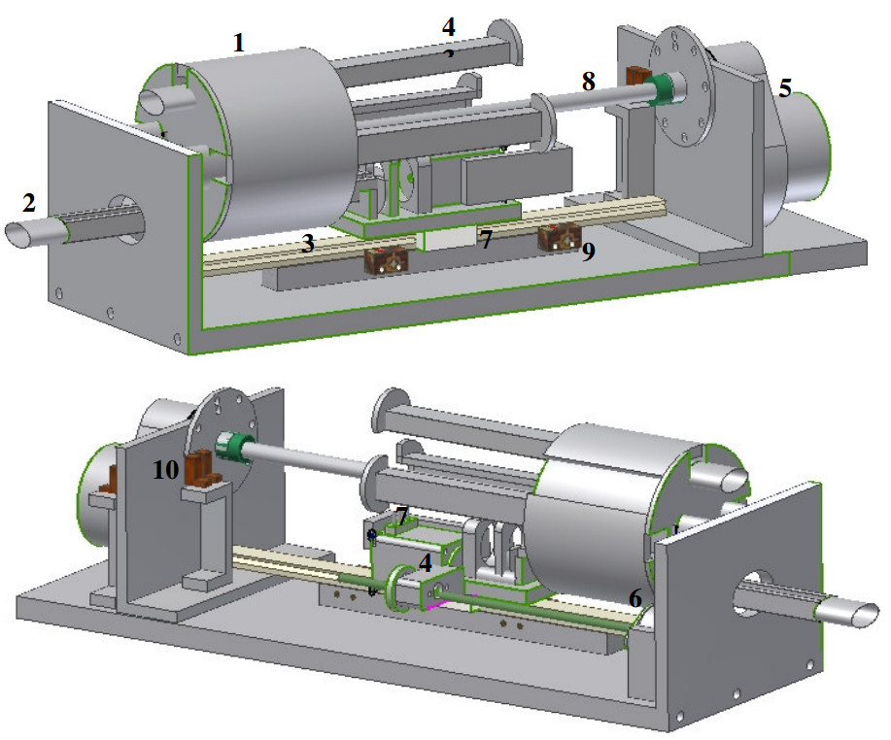
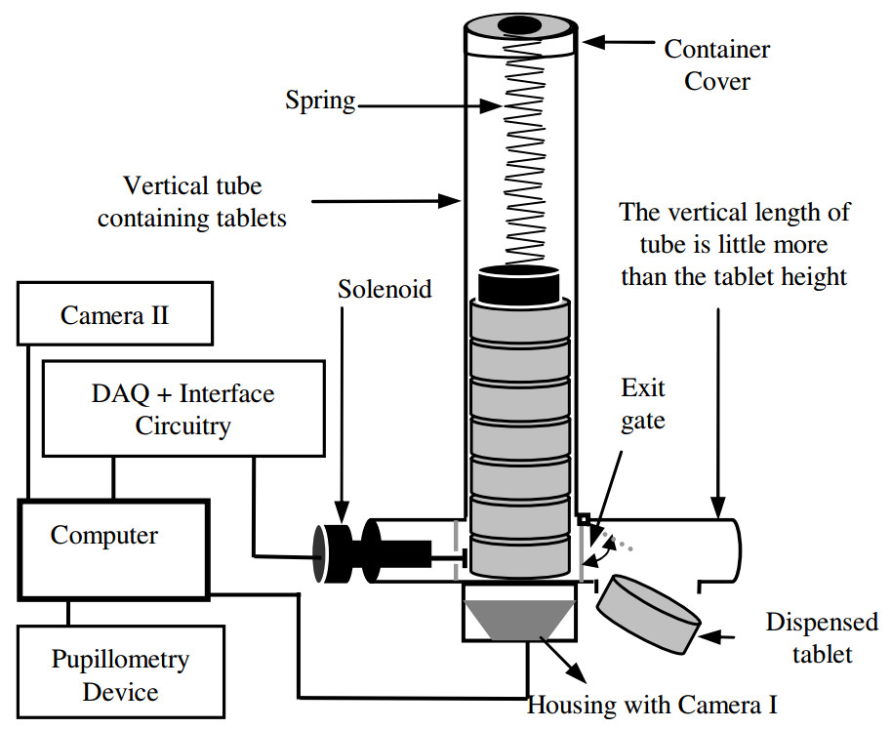
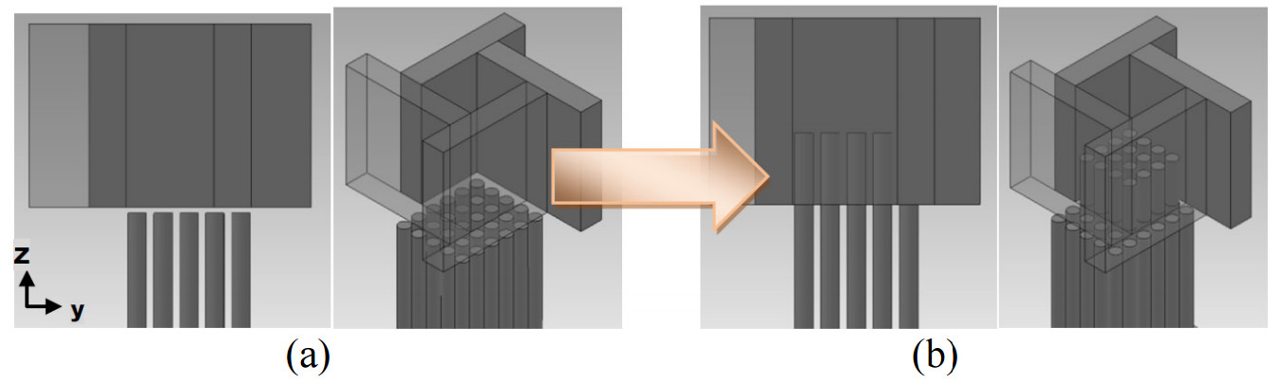
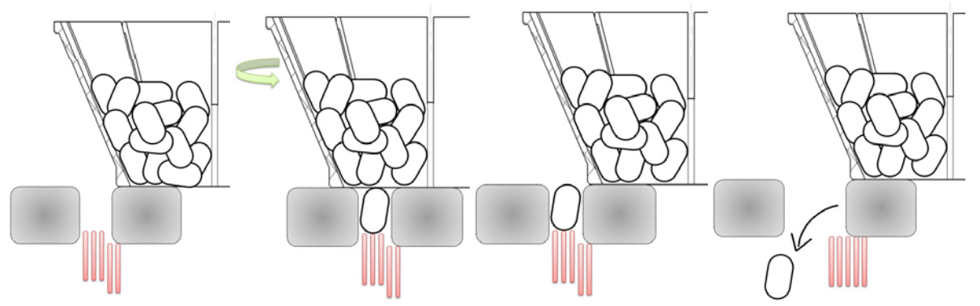
Proposed design of medication dispenser from the group at UT [1].
Various pictures of the 3D Adjustable cavity Medication Dispenser [3].
Dispensing mechanism for Medication dispenser for narcotic rehabilitation with cover removed [2].
Notes:
Medication Dispenser, University of Tasmania
Gravity fed
Lack of sensors

Slide 6
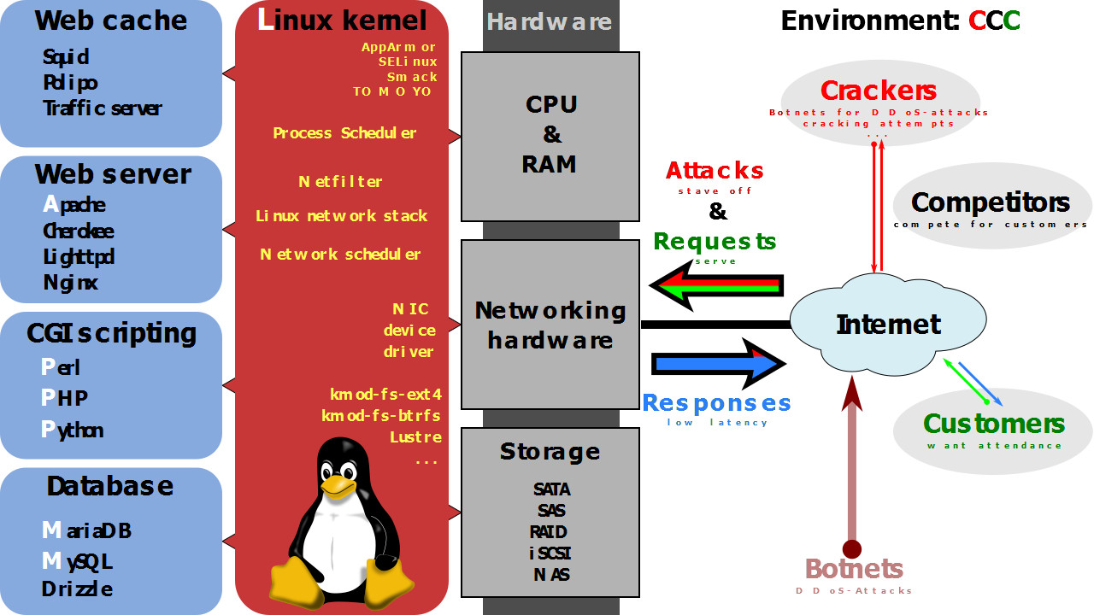
A picture of the LAMP stack architecture description in a flow diagram format [4].
Notes:
LAMP STACK
Apache over Nginx
More popular more support
Uses HTTP (hypertext transfer protocol)
Interprets a request from a browser that requests information from the web server
In most cases the server will return a file with HTML code to display a website on the requesting browser

Slide 7
Communicaions:
I2C
UART
RS485
RFID
Low frequency
Passive tag
UCT’s solution
Notes:
I2C or UART
Common mode noise rs485 is immune
RS485 chosen as there are many chips that allow the use of this protocol with UART interfaces.
A cheap and commonly used RFID module with a UART to USB converter to enable it to interface with any computer with a USB port
ATX standard for the pinout of computer Power Supplies was reviewed

Slide 8
Design Flow
Mechanical Design
IC Guide
Delivery Mechanism
Enclosure
Electrical Design
Raspberry Pi HAT
MCU Module
LCD Module
Software Design
Website
Master Program
MCU Program

Slide 9
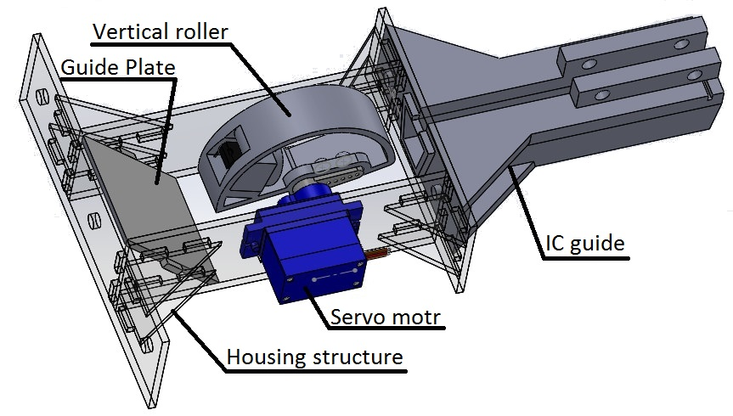
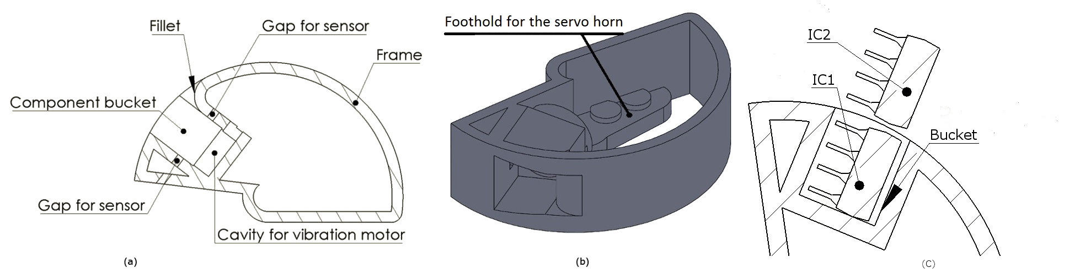
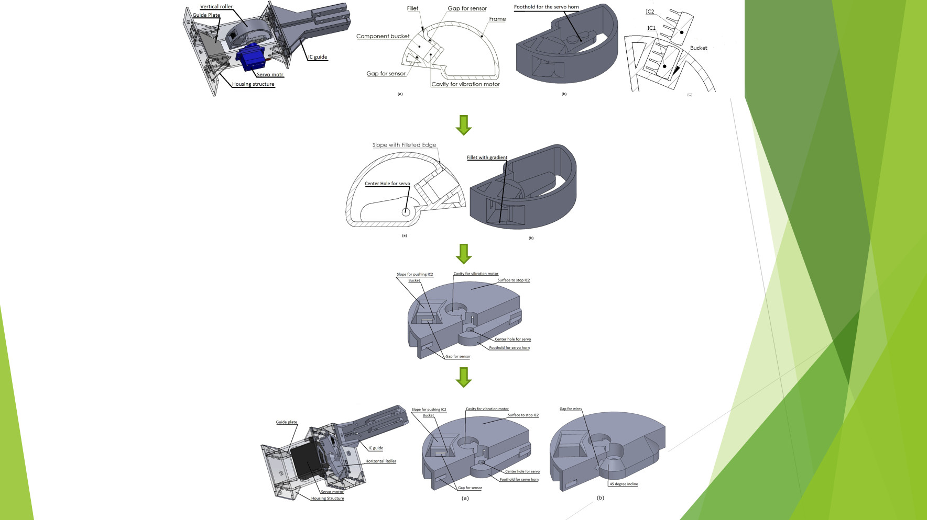
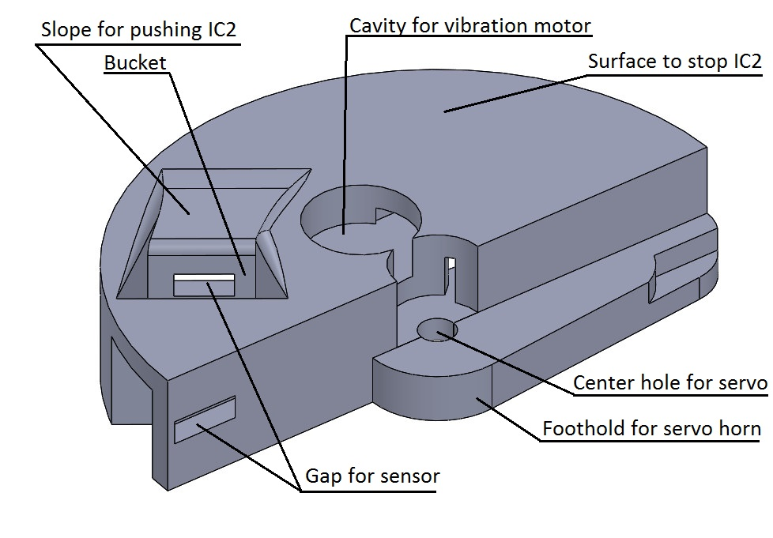
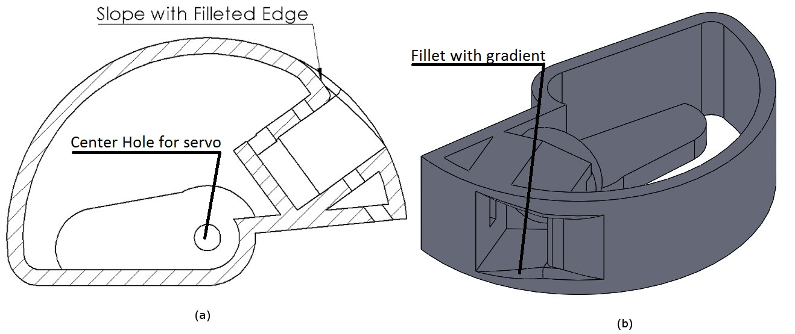
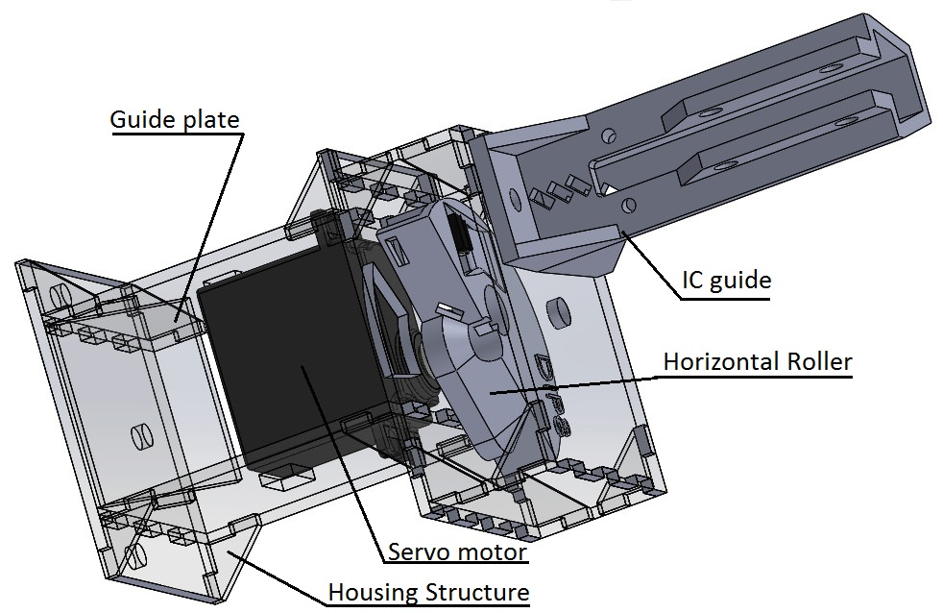
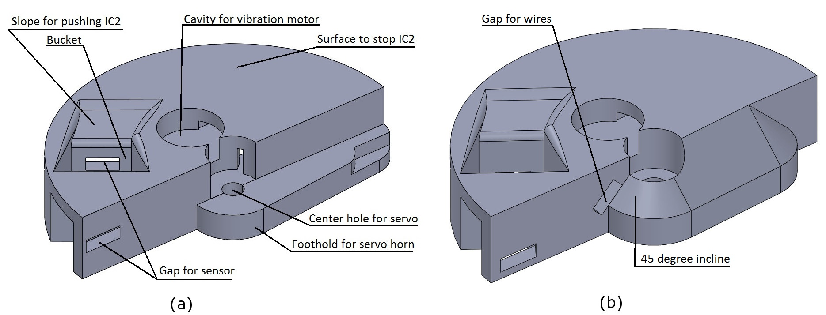
Vertical Roller Version 1
Vertical Roller Version 2
Horizontal Roller Version 1
Horizontal Roller Final Version

Slide 10
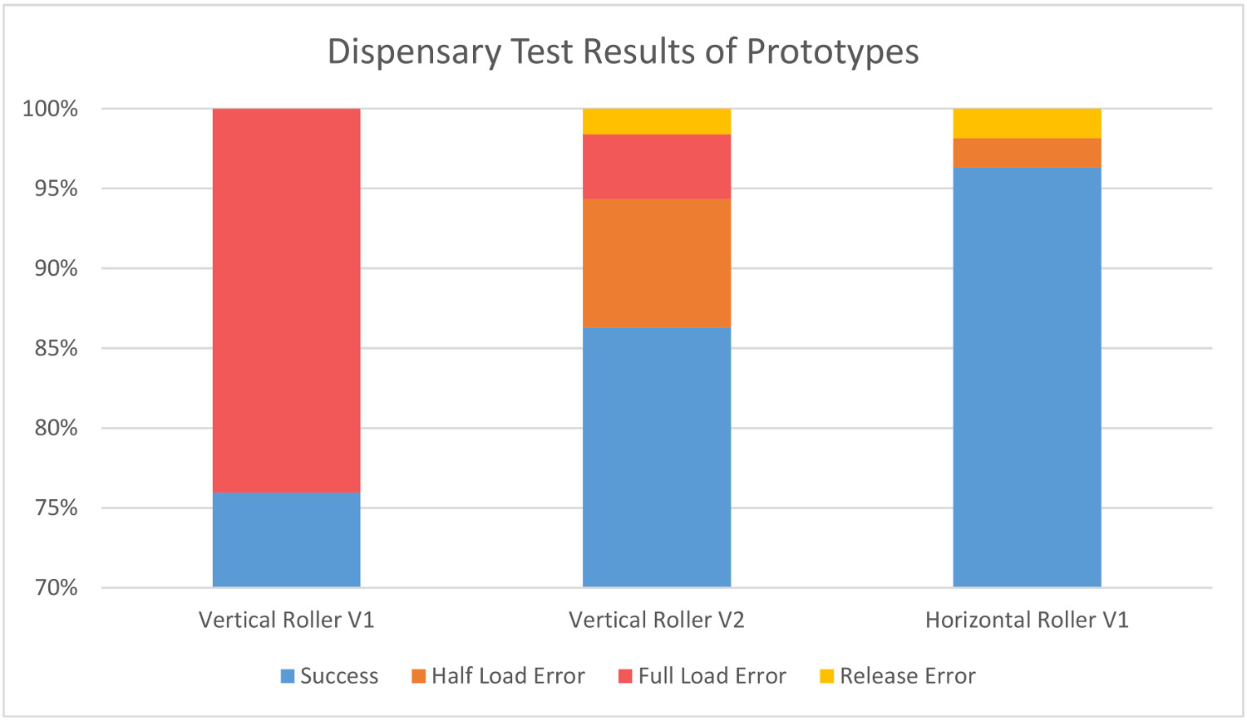
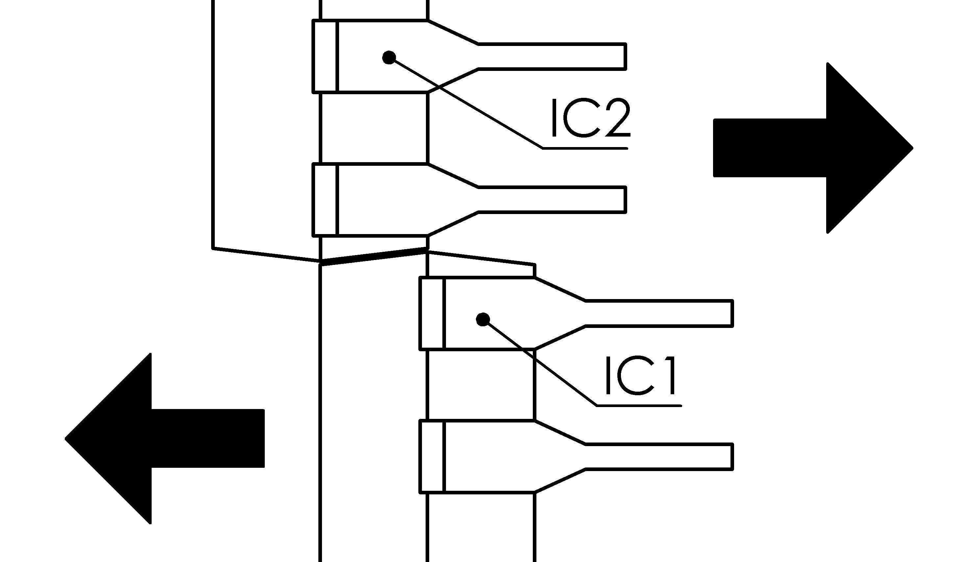

Slide 11
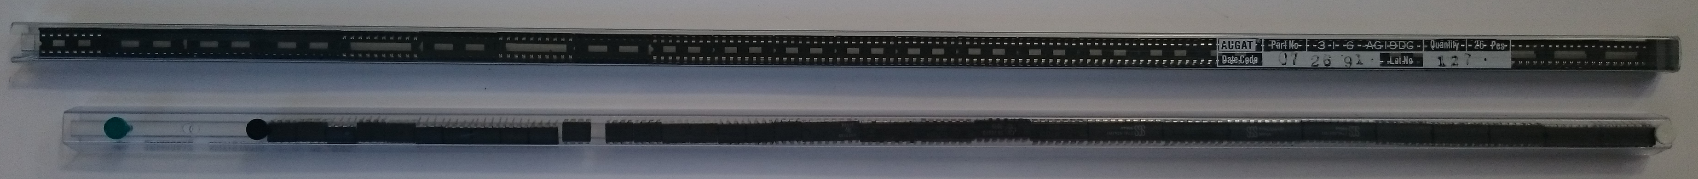

Slide 12
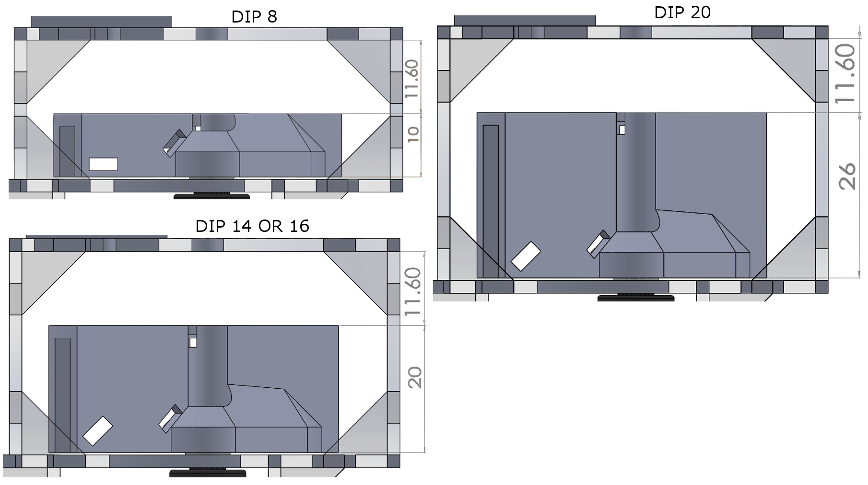
DIP 8
DIP14/16
DIP 20
DIP 8 Socket
DIP 14/16 Socket
DIP 20 Socket

Slide 13
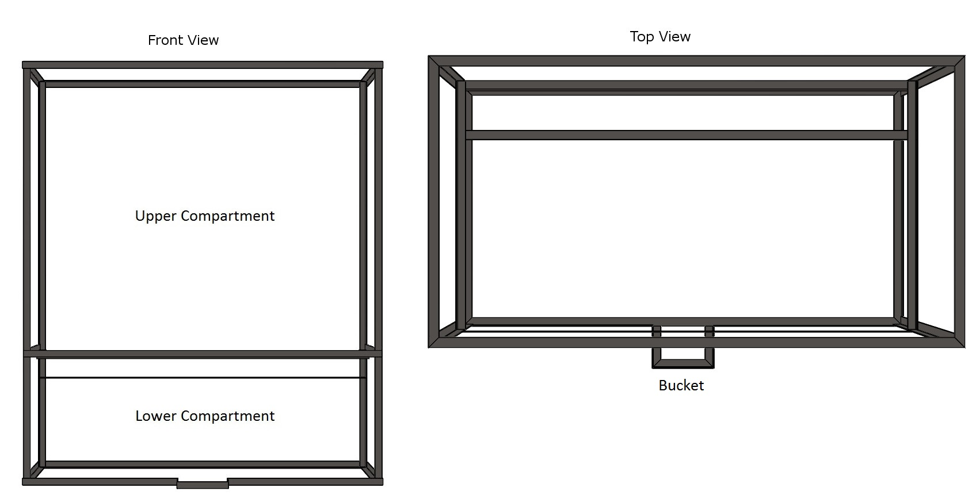
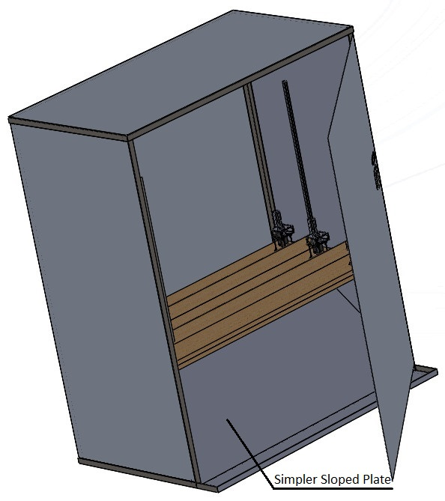
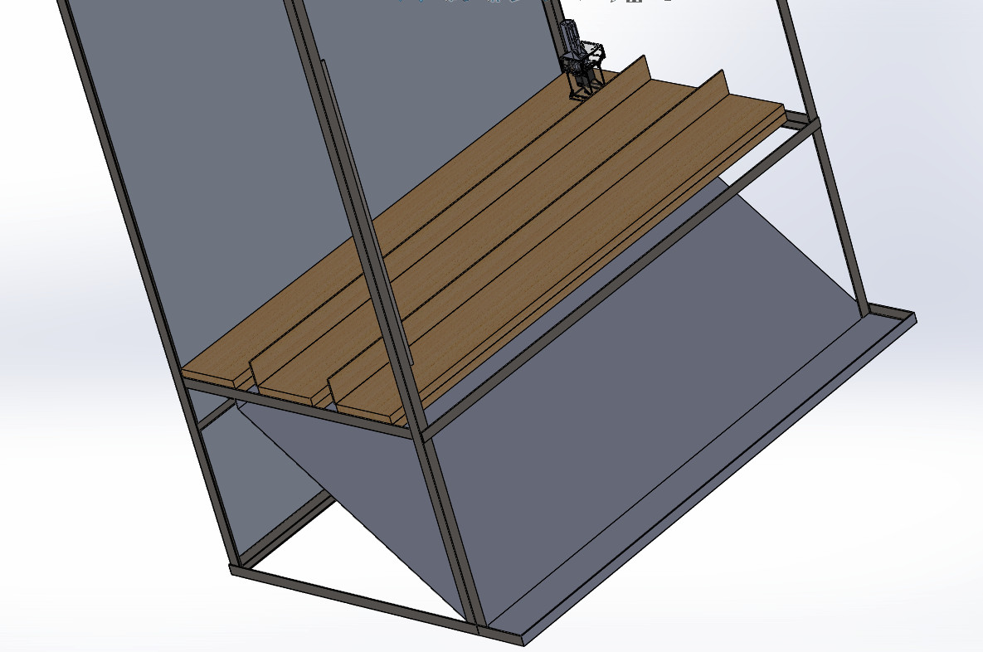

Slide 14
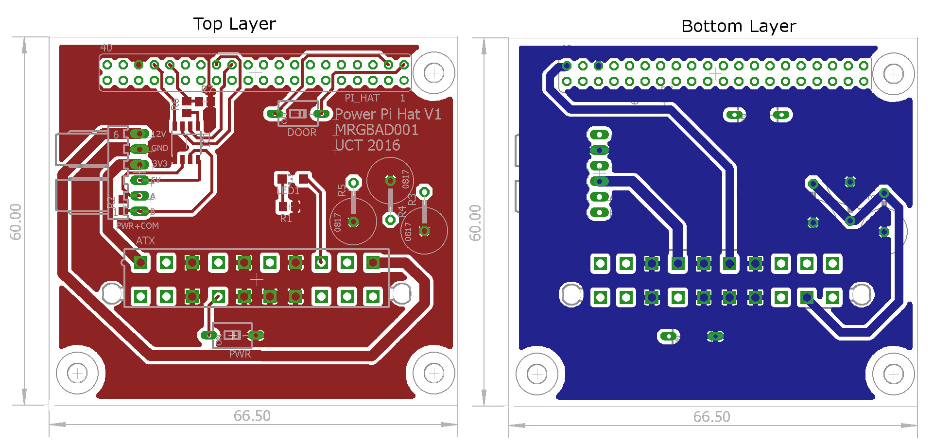
RS485 Communications
ATX Plug
Daisy Chain connection
Fits on top of Raspberry Pi
Door sensor
Power Switch

Slide 15
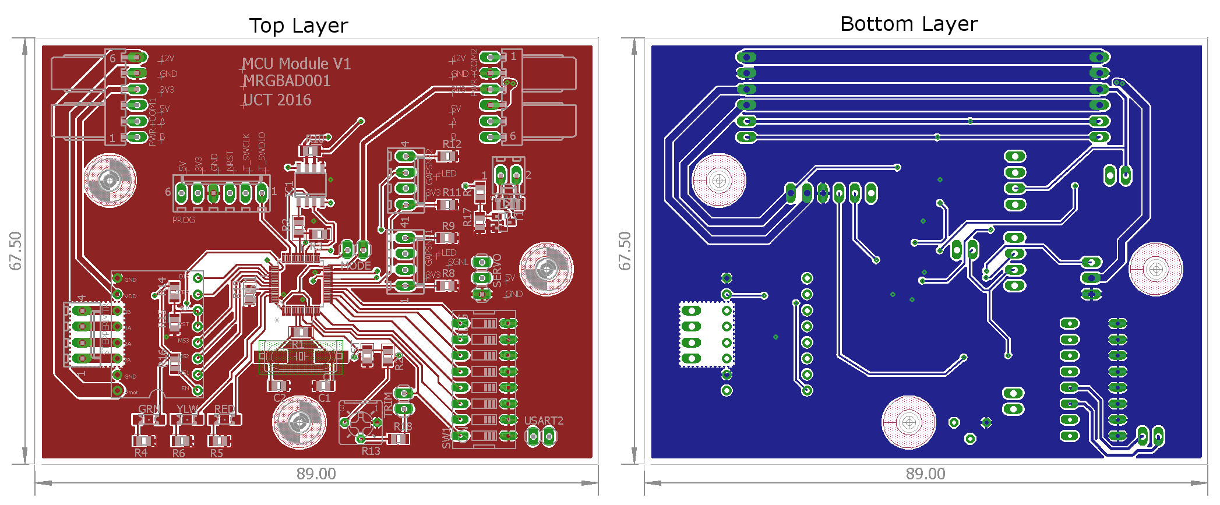
Addresable
RS485 Communications
Calibration
Sensors
Servo, DC, Stepper motor
Daisy chain bus
Status LEDs

Slide 16
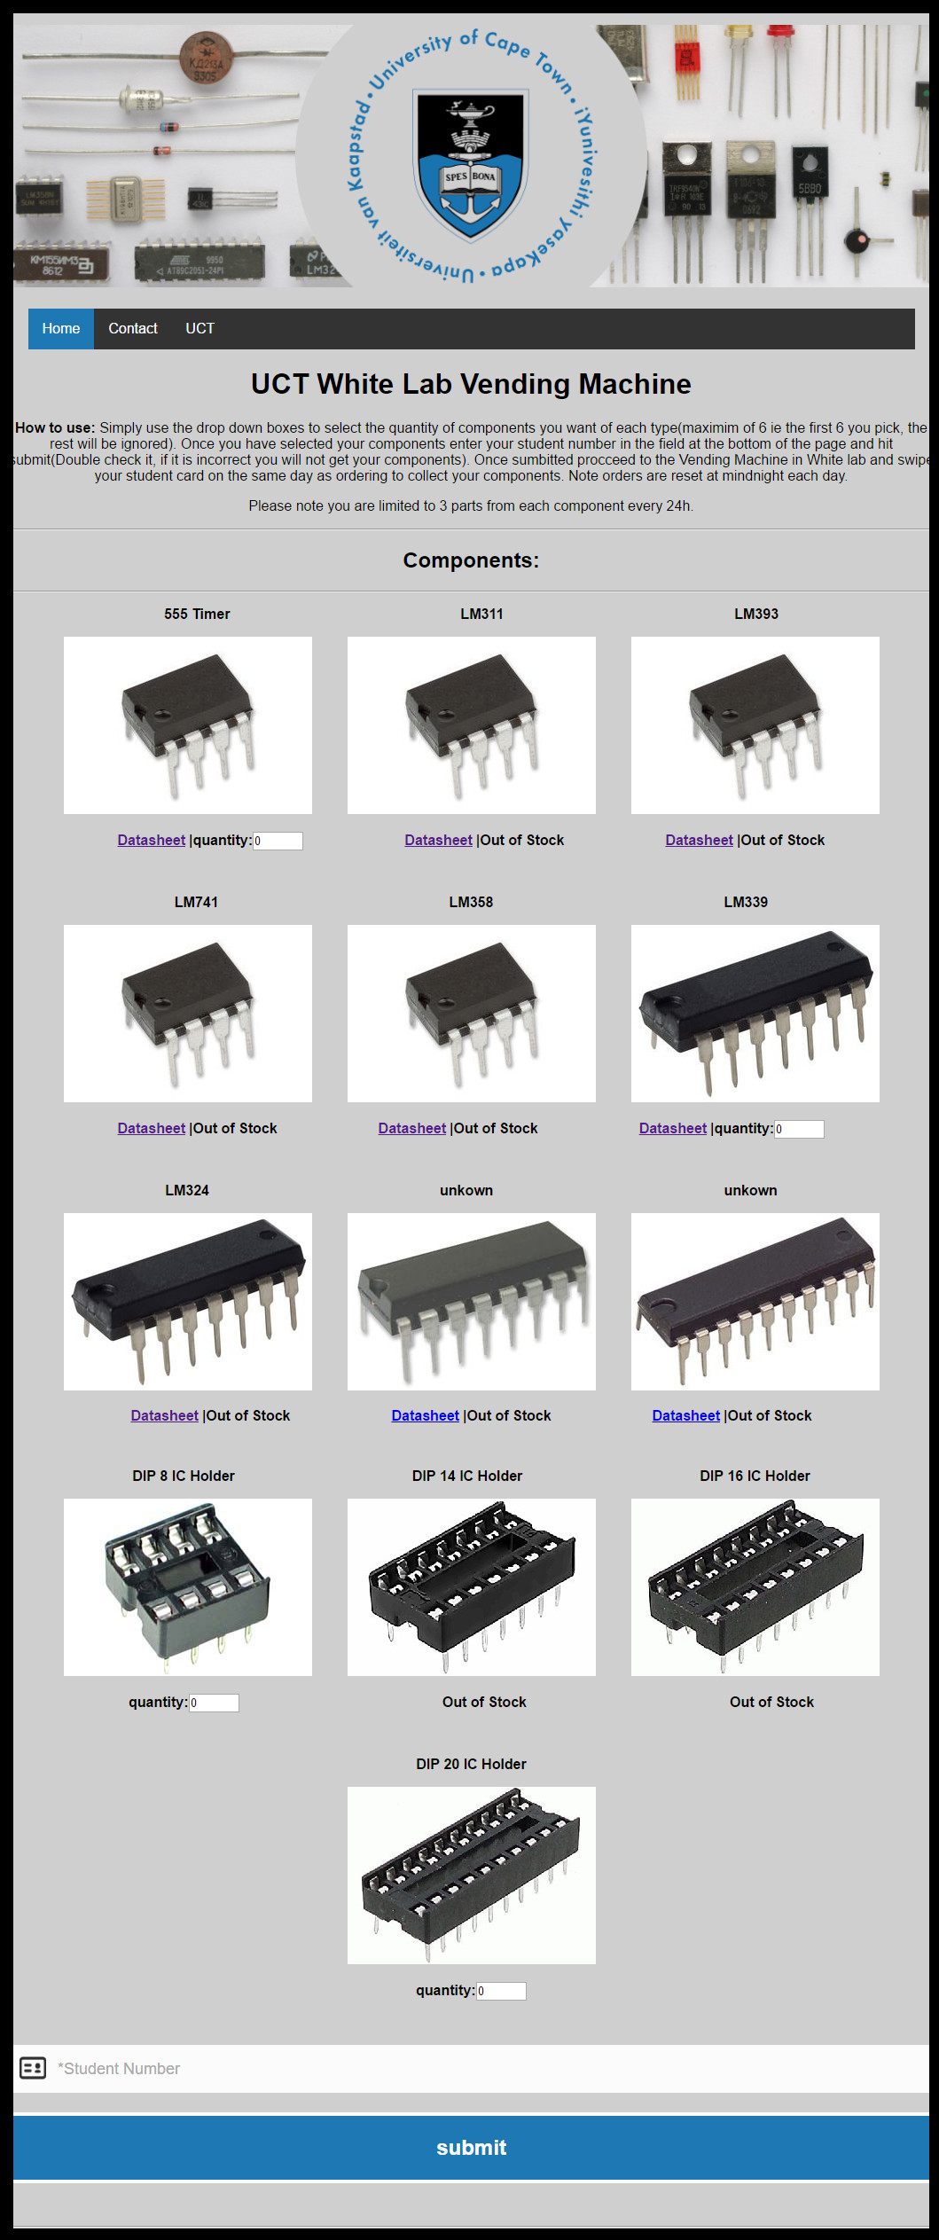

Slide 17
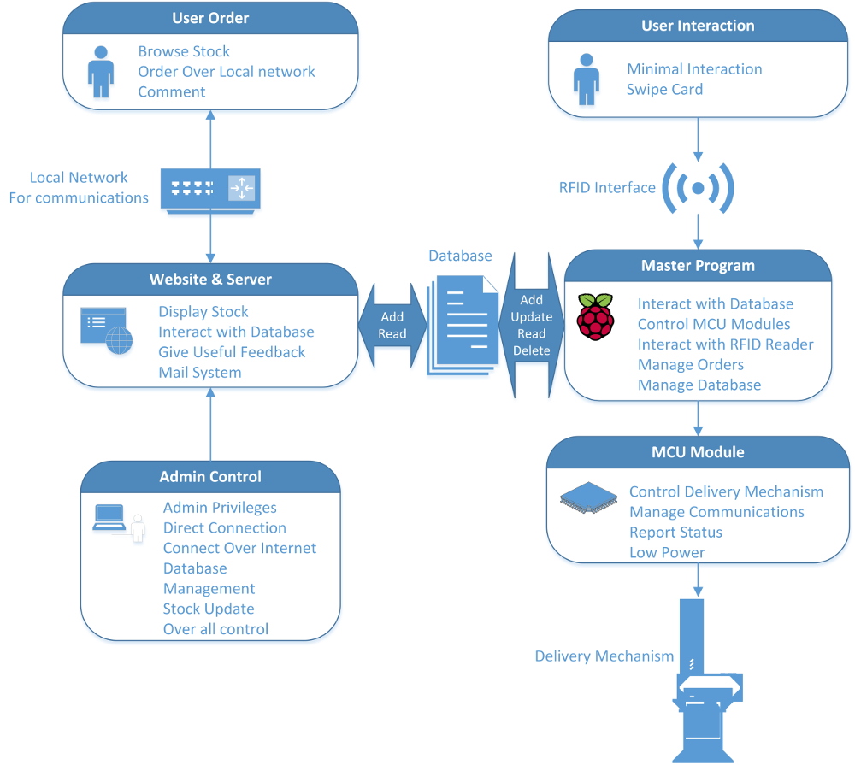

Slide 18
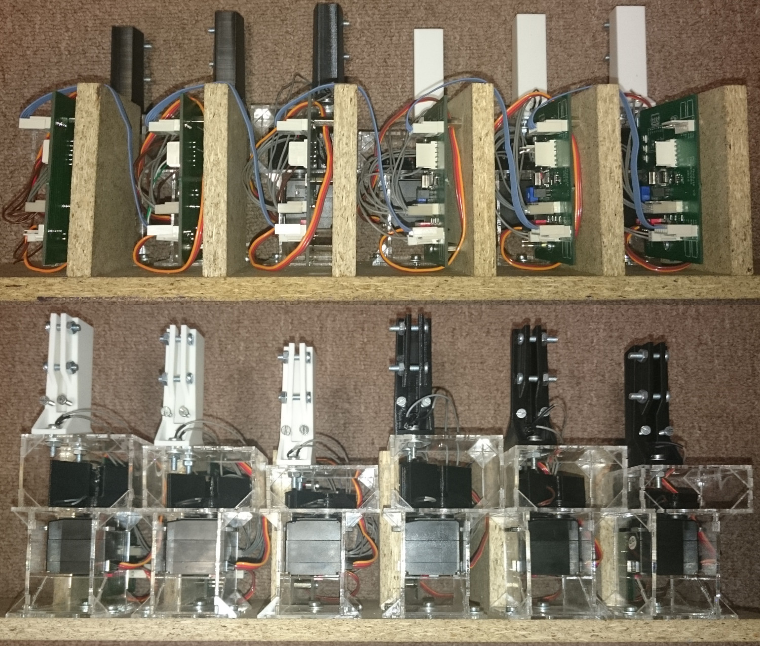
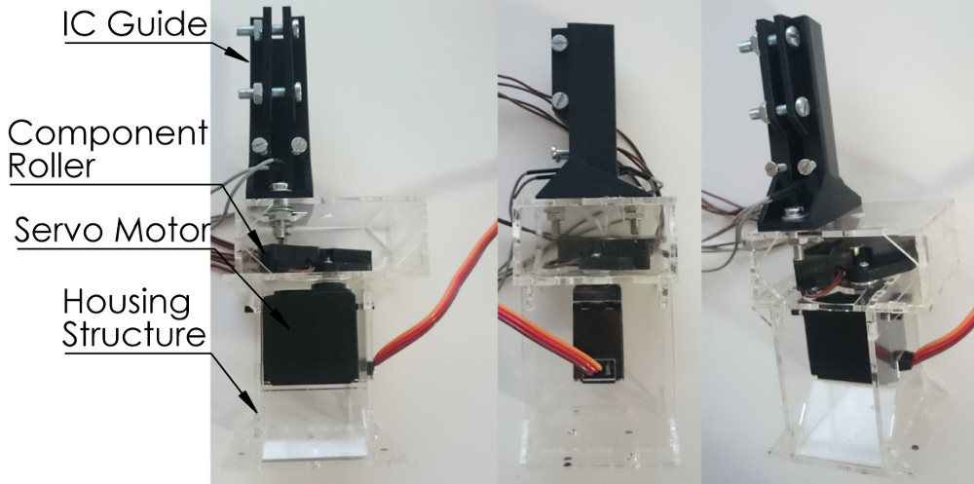
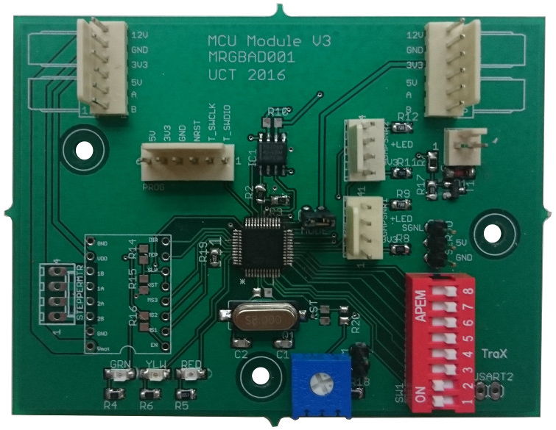
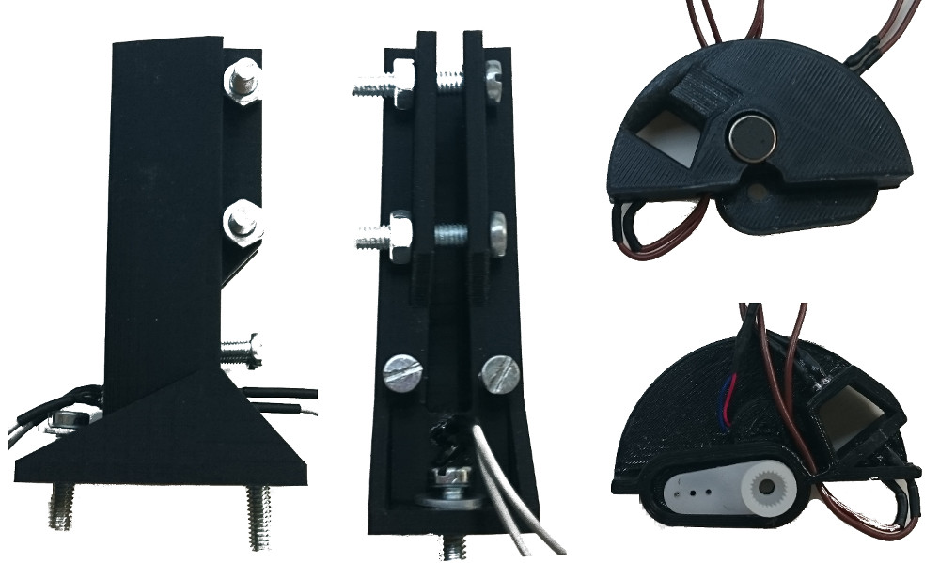
Back View
Front View
Assembly

Slide 19
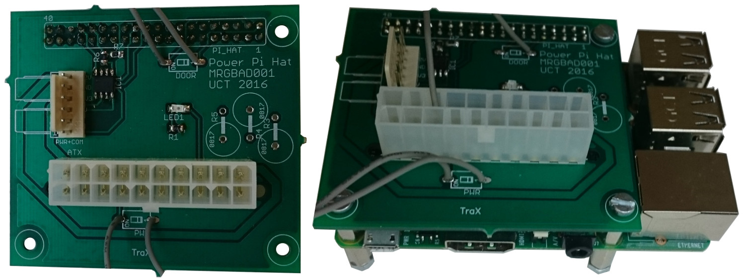

Slide 20
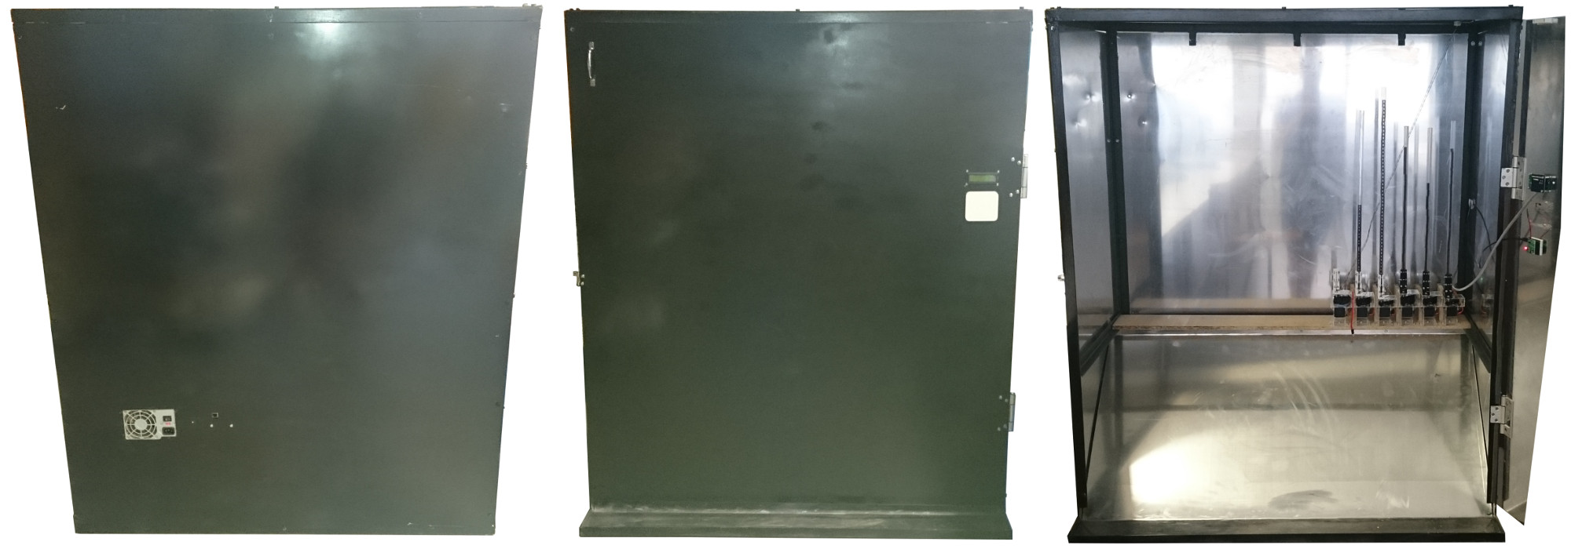

Slide 21
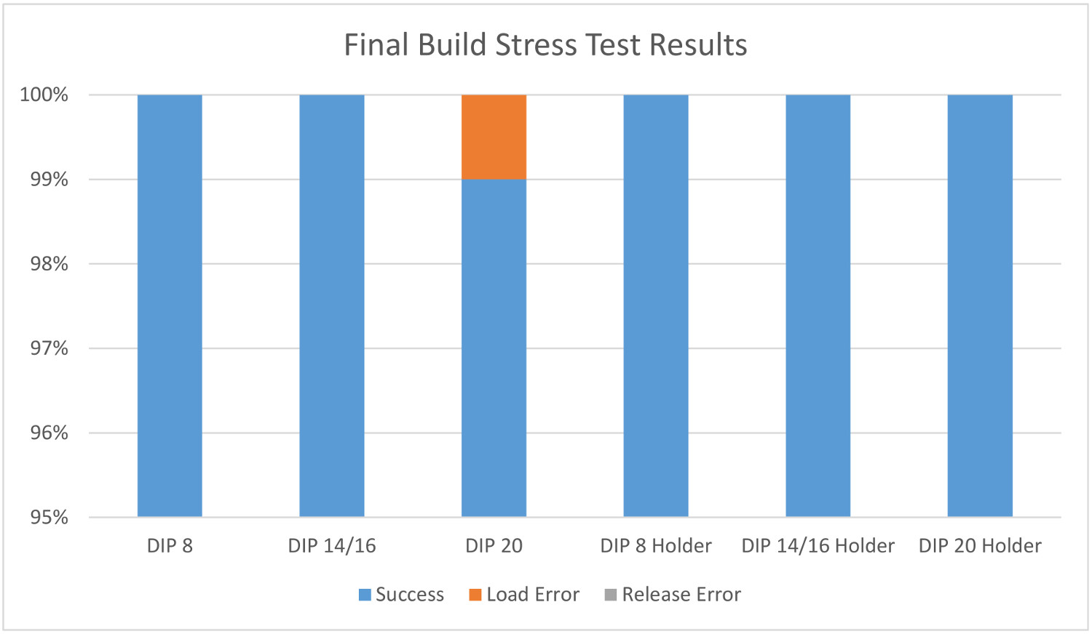
Results and Final Testing

Slide 22
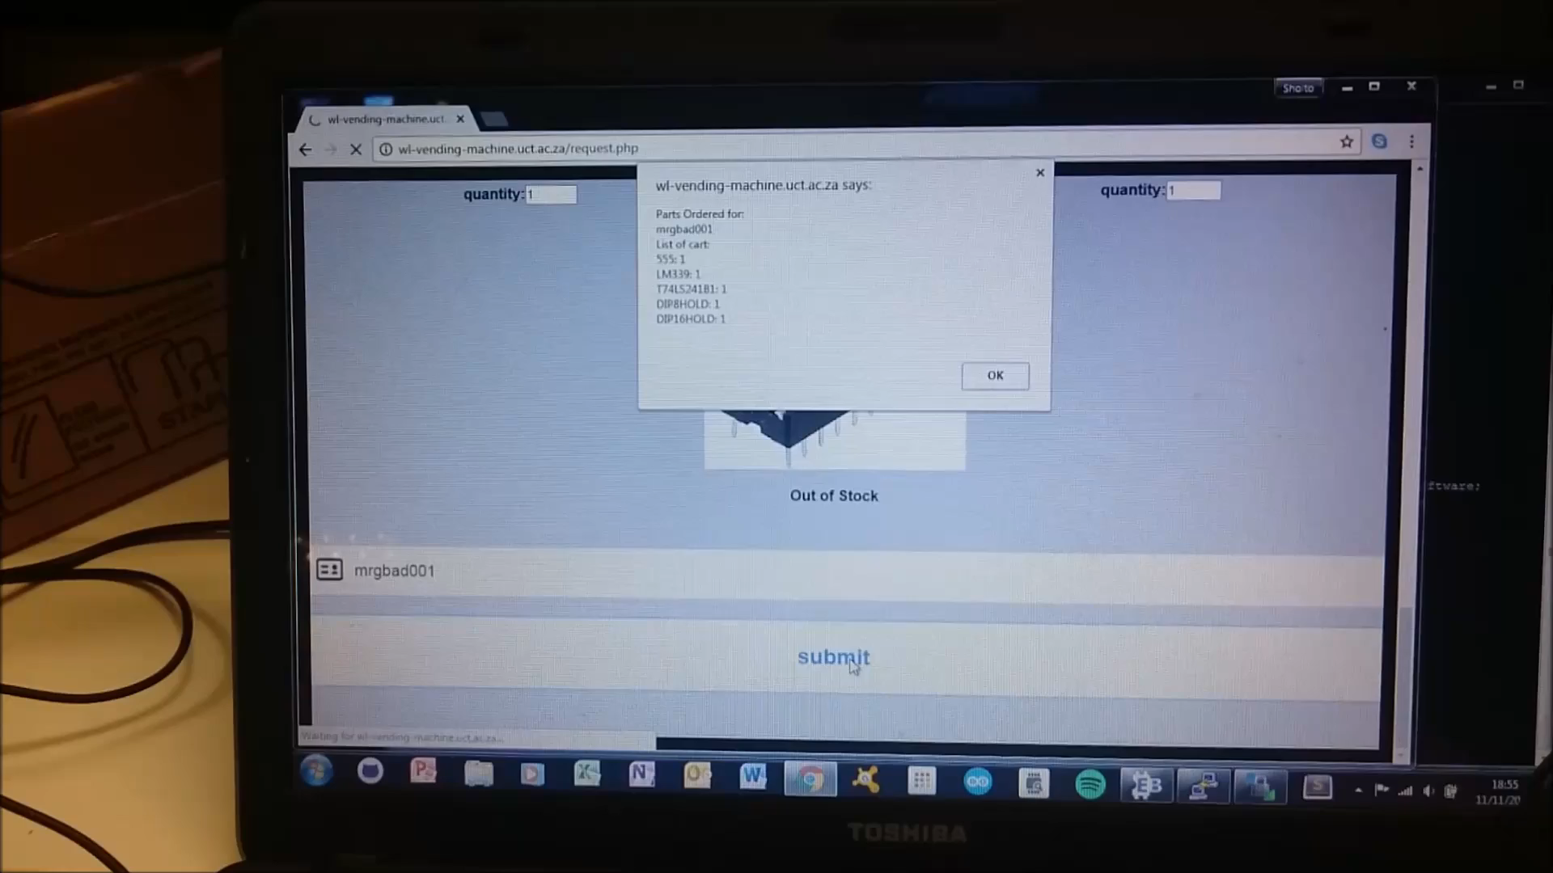

Slide 23
Conclusion and Recommendations
Enclosure
Sturdier Frame
Paint job presentability
PCB
Stabilizing Capacitors
RFID
Redesign, too close to aluminium door
Website
Lacks proper admin tools
Longevity
Future of the Vending Machine
Notes:
In closing I feel that the designs presented in this
study are more than suitable to solve the problem of acquisition for the
Students. I also believe that this project should continue and improvements should be
Made to make the system even better

Slide 24
References
S. G. Patil and T. J. Gale, “Preliminary design of remotely used and monitored medication dispenser,” in Engineering in Medicine and Biology Society, 2006. EMBS ’06. 28th Annual International Conference of the IEEE, Aug 2006, pp. 3616–3619.
T. J. G. V. Q. Ho and C. R. Stack, “Medication dispenser for narcotic rehabilitation patients,” in 2009 Annual International Conference of the IEEE Engineering in Medicine and Biology Society, Sept 2009, pp. 1742–1745.
S. L. J. N. C. K. Toh and Y. O. Tan, “Three dimensional adjustable cavity for flexible singulation of multiple medications in an automated medication dispenser,” in 2012 IEEE International Conference on Automation Science and Engineering (CASE), Aug 2012, pp. 347–352.
https://en.wikipedia.org/wiki/LAMP_(software_bundle)#/media/File:LAMP_software_bundle.svg
Notes:
Thank you for listening are there any questions

